Slide 1

Logic
Presented by:
Elizer Ponio Jr.
Department of Computer Science
College of Computing and Information Technologies

Slide 2
Outline
Introduction and Definition
Statements
Conditional Statements
Quantifiers

Slide 3
Statements
Proofs rely entirely on logic
Logic is the process of deducing information correctly — it is not the process of deducing correct information
The building blocks of logic are statements.
A statement is a sentence or a mathematical expression that is either TRUE or FALSE

Slide 4
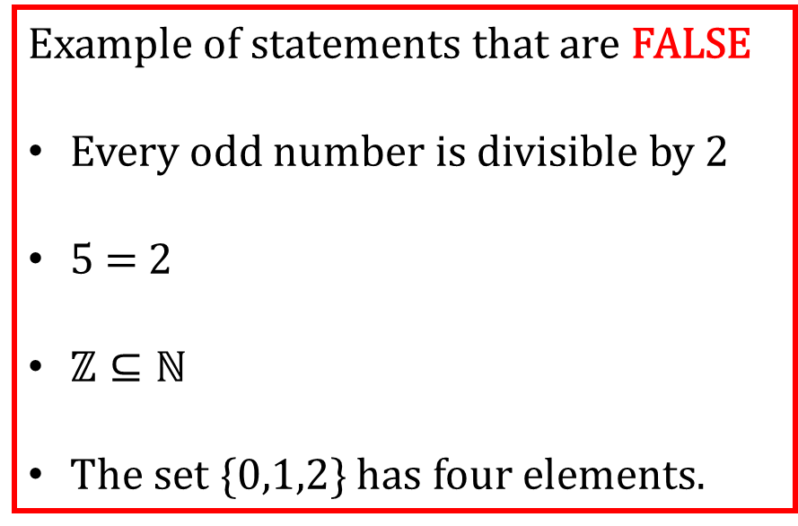
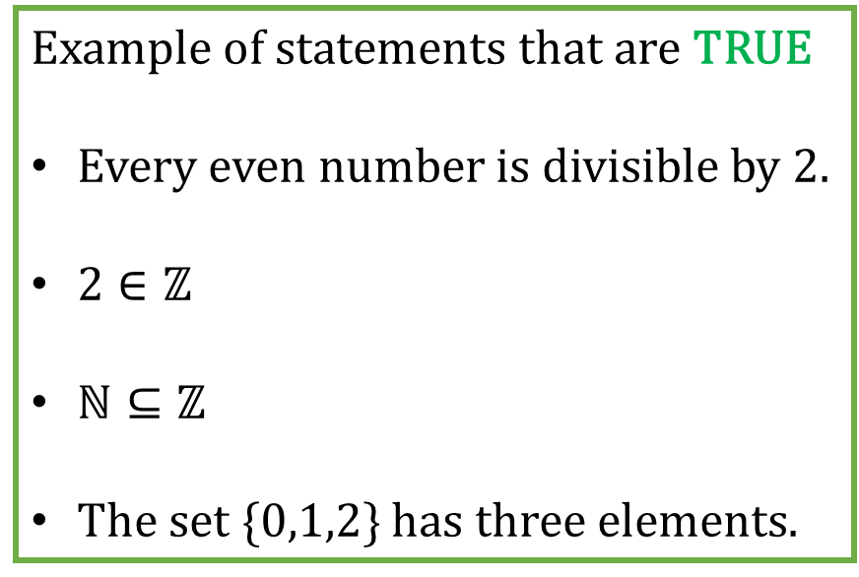
Statements
Example of statements that are TRUE
Every even number is divisible by 2.
$2∈ℤ$
$ℕ⊆ℤ$
The set {0,1,2} has three elements.
Example of statements that are FALSE
Every odd number is divisible by 2
5 = 2
$ℤ⊆ℕ$
The set {0,1,2} has four elements.

Slide 5
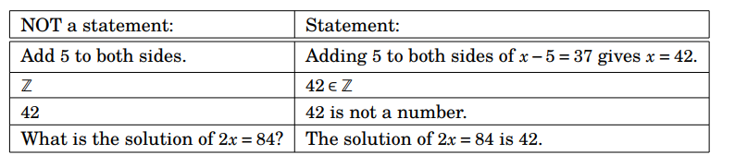
Statements

Slide 6
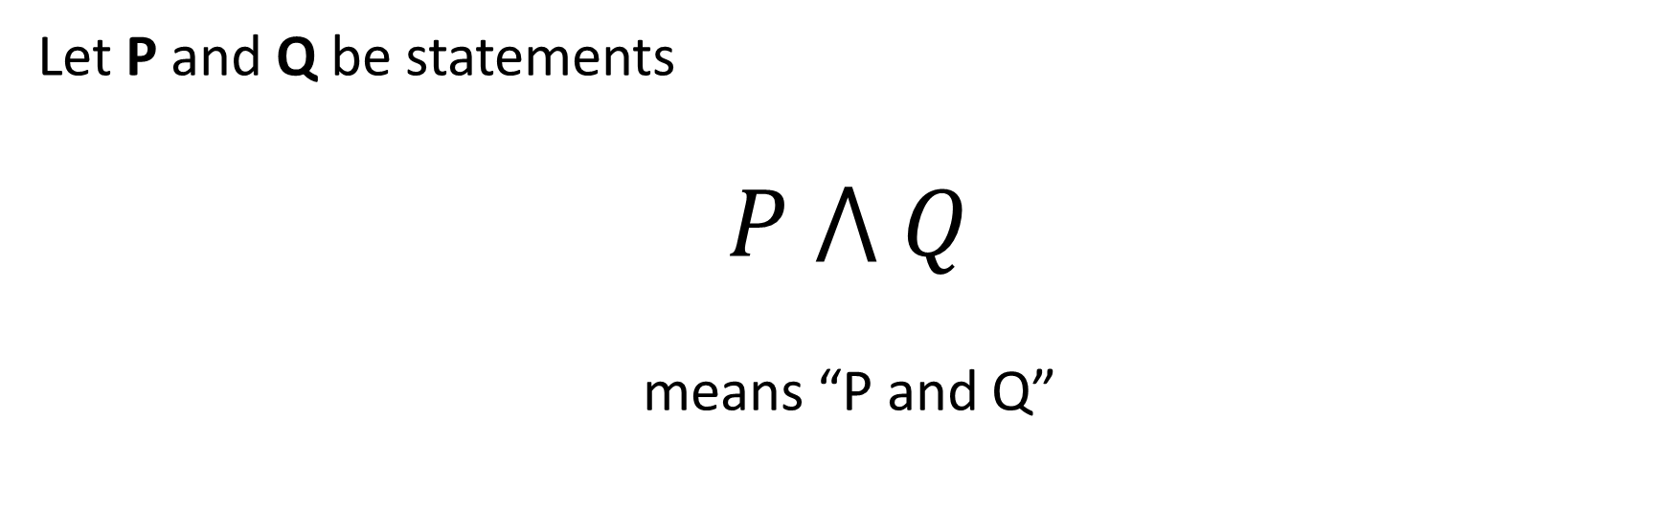
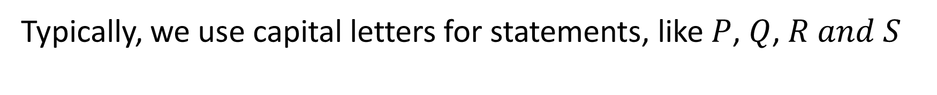
Notations (AND)
Typically, we use capital letters for statements, like $P$, $Q$, $R and S$
Let P and Q be statements
$$P ⋀ Q$$
means “P and Q”

Slide 7
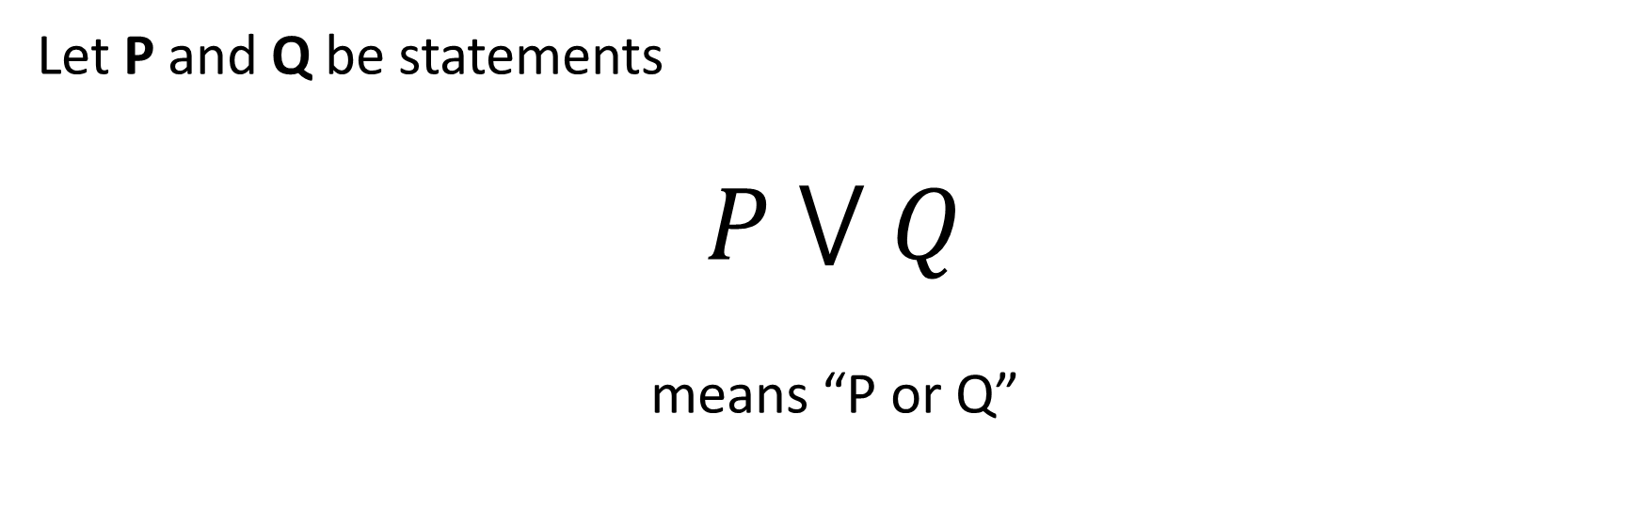
Notations (OR)
Typically, we use capital letters for statements, like $P$, $Q$, $R and S$
Let P and Q be statements
$$P ⋁ Q$$
means “P or Q”

Slide 8

Notations (NOT)
Typically, we use capital letters for statements, like $P$, $Q$, $R and S$
Let P and Q be statements
$$∼P$$
means “not P”

Slide 9
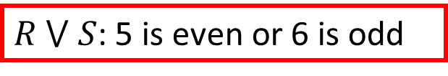
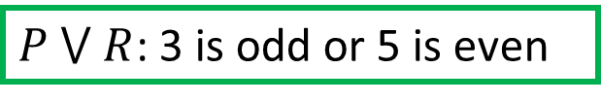
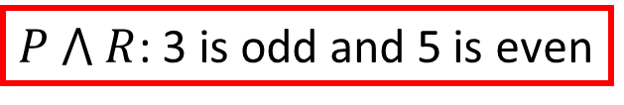

Statements
Consider the following statements:
P: The number 3 is odd
R: The number 5 is even
Q: The number 4 is even
S: The number 6 is odd
Then,
$P ⋀ Q$: 3 is odd and 4 is even
$P ⋁ R$: 3 is odd or 5 is even
$P ⋀ R$: 3 is odd and 5 is even
$R ⋁ S$: 5 is even or 6 is odd

Slide 10
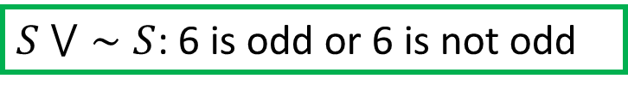
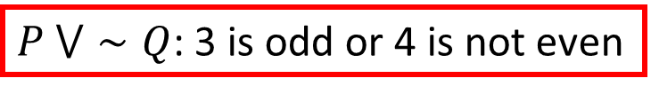
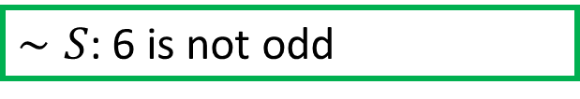
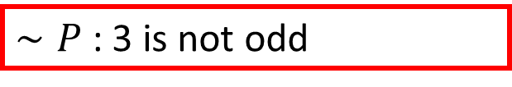
Statements
Consider the following statements:
P: The number 3 is odd
R: The number 5 is even
Q: The number 4 is even
S: The number 6 is odd
Then,
$∼P$: 3 is not odd
$P ⋁∼Q$: 3 is odd or 4 is not even
$∼S$: 6 is not odd
$S ⋁∼S$: 6 is odd or 6 is not odd

Slide 11
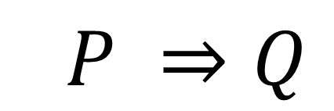
Conditional Statements
$$P ⇒Q$$
means “P implies Q”
In proofs, it means that we have an assumption P and we are trying to prove some conclusion Q
It is an if-then statement

Slide 12






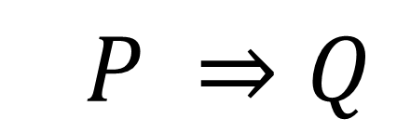



Conditional Statements
$$P ⇒Q$$
$If P, then Q$
$Whenever P, then also Q$
$P implies Q$
$P is a sufficient condition for Q$
$P only if Q$
$For Q, it is sufficient that P$
$Q whenever P$
$For P, it is necessary that Q$
$Q, provided that P$

Slide 13
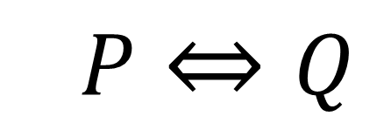
Conditional Statements
$$P⇔Q$$
means “P if and only if Q”

Slide 14


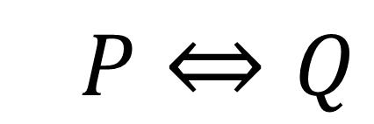

Conditional Statements
$$P⇔Q$$
$P is equivalent to Q$
$P is a necessary and sufficient condition for Q$
$If P, then Q, and conversely$
$For P, it is necessary and sufficient that Q$
$P implies Q and Q implies P$

Slide 15












Conditional Statements
Example:
$$Let x ∈ ℝ$$
$$P ⇒Q$$
$$x>10⇒x>6$$
$$x=12$$
$$T$$
$$T$$
$$x=8$$
$$F$$
$$T$$
$$x=3$$
$$F$$
$$F$$

Slide 16




Conditional Statements
Example:
$$Let n ∈ ℤ$$
$$n is even ⇐n is a multiple of 4$$
$$n is even⇔n+1 is odd$$
If and only if
$P⇔Q$
$P and Q both TRUE or both FALSE$
$P⇒Q and Q⇒P$
$P and Q are equivalent$

Slide 17
Conditional Statements
Example:
$$0>1⇒\text{103574289 }\text{is} \text{prime}$$
FALSE
???
TRUE

Slide 18

Quantifiers
A quantifier is an expression which indicates the number (or quantity) of our objects.
For example: “For all n $∈$ $ℕ$, n is even.”
Saying “For all n $∈$ $ℕ$” means that we are asserting that all of the infinitely many n-values in N have the property.

Slide 19
Quantifiers
Another example: “There exists some n $∈$ $ℕ$ such that n is even.”
Saying “there exists some n $∈$ $ℕ$” means that we are asserting that at least one n-value in N has the property

Slide 20
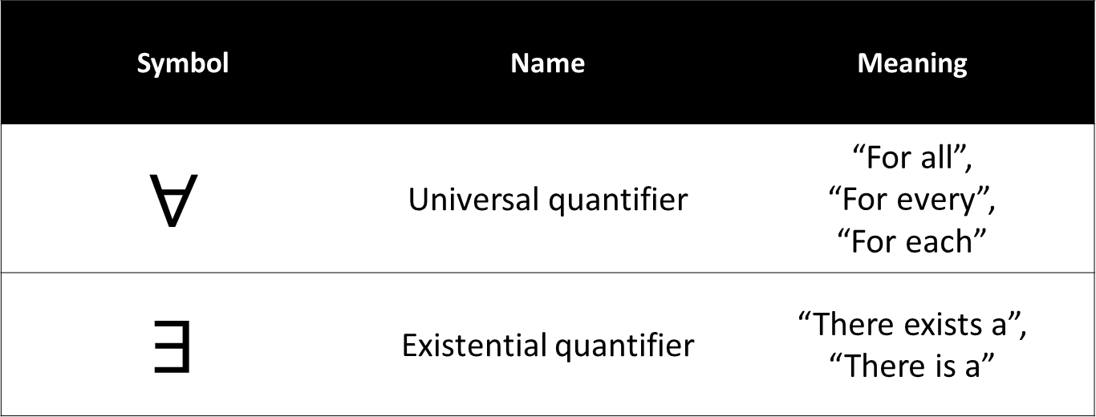
Quantifiers
Symbol | Name | Meaning
$$∀$$ | Universal quantifier | “For all”, “For every”, “For each”
$$∃$$ | Existential quantifier | “There exists a”, “There is a”

Slide 21

Quantifiers
Example:
$$∀ x∈ ℝ, { x}^{2}≥0$$
$$\text{Translation}\text{: }\text{For} \text{every} \text{real} \text{number} x\text{,} x squared is greater than or equal to zero$$
TRUE

Slide 22

Quantifiers
Example:
$$∀ x∈ ℤ, x>π$$
Translation: For every integer x, x squared is greater than pi
FALSE
This will be false if x = 1

Slide 23


Quantifiers
Example:
$$∃ x∈ ℝ{ such that x}^{2}=5$$
Translation: Ther exists a a real number such that x squared is equal to 5
$$TRUE if x=−\sqrt{5}$$

Slide 24


Quantifiers
Example:
$$∃ x∈ ℝ{ such that x}^{2}=−1$$
Translation: There exists a real number such that x squared is equal to negative 1
$$FALSE$$

